Slide 1
Task 2.3 User Research Analysis
By: Minal Bombatkar

Slide 2
Research Goals
In the following charts, I executed the 4 stages of Research Analysis:
1. Collect and organize data
(i.e. research data obtained from the previous survey and user interviews conducted)
2. Explore the data for Findings
(A Finding is usually a fact that tells us “what” is happening, but it doesn’t tell us
the “why” nor provide us with a way to find a meaningful solution.)
3. Sort and map the data
(i.e. create an Affinity Map)
4. Identify user Insights
(An insight, on the other hand, is something that describes an aspect of human
behaviour/motivation and enables us to see how we might take actions to solve a
problem.)

Slide 3
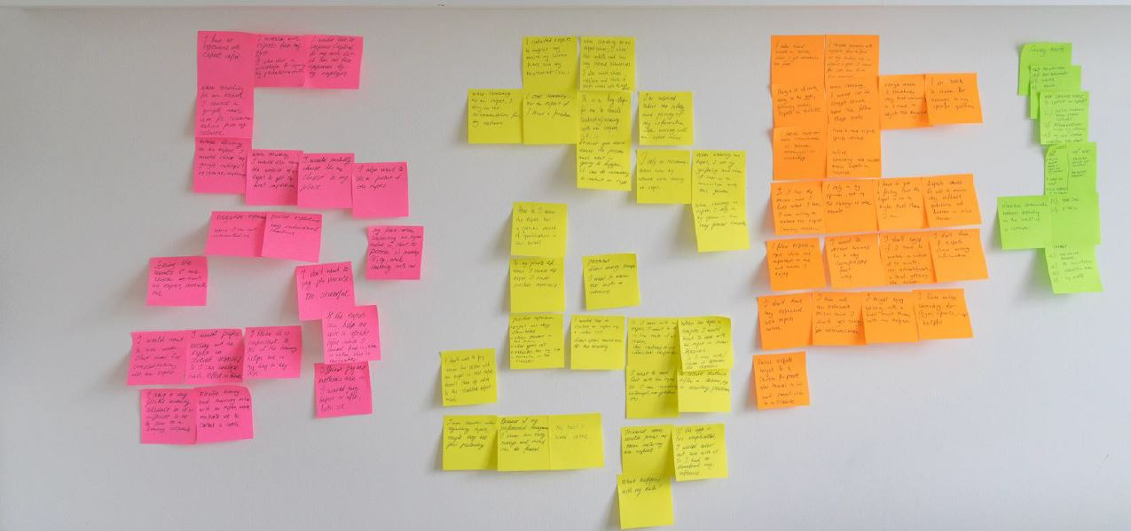
Collect and organize data
In the first step, I documented the results of the online survey focused on collecting the quantitative data.
Next, I documented each interview based on the notes for each participant.
The overview shows all the questions and user answers, plus their quotes.
Finally, I used color-coded sticky notes to record my interview partners.
5. From this picture, it is hard to read the data so decided to create digital copy of all sticky notes.

Slide 4
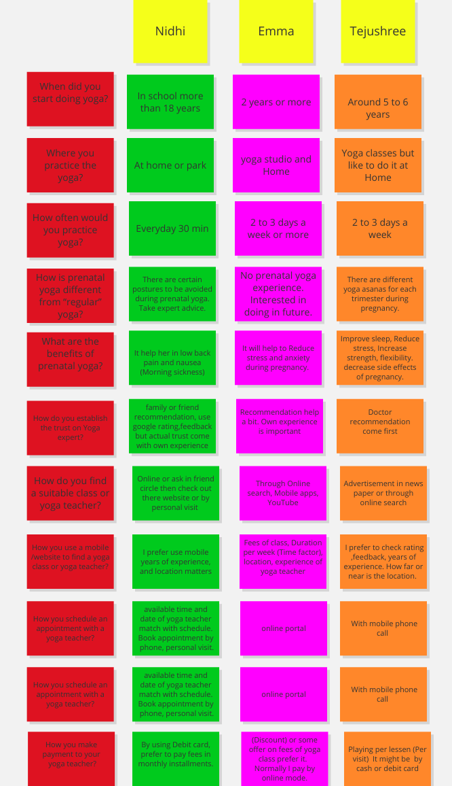
Explore the data for Findings
After organising the data,
Identified behaviors/attitudes, needs/goals, pain points, and quotes from user interview.
Documented in digital copy, so that is easy to maintain for future references and without much efforts reading is possible with zoom option.
** Click on image to view the digital copy of a board.

Slide 5
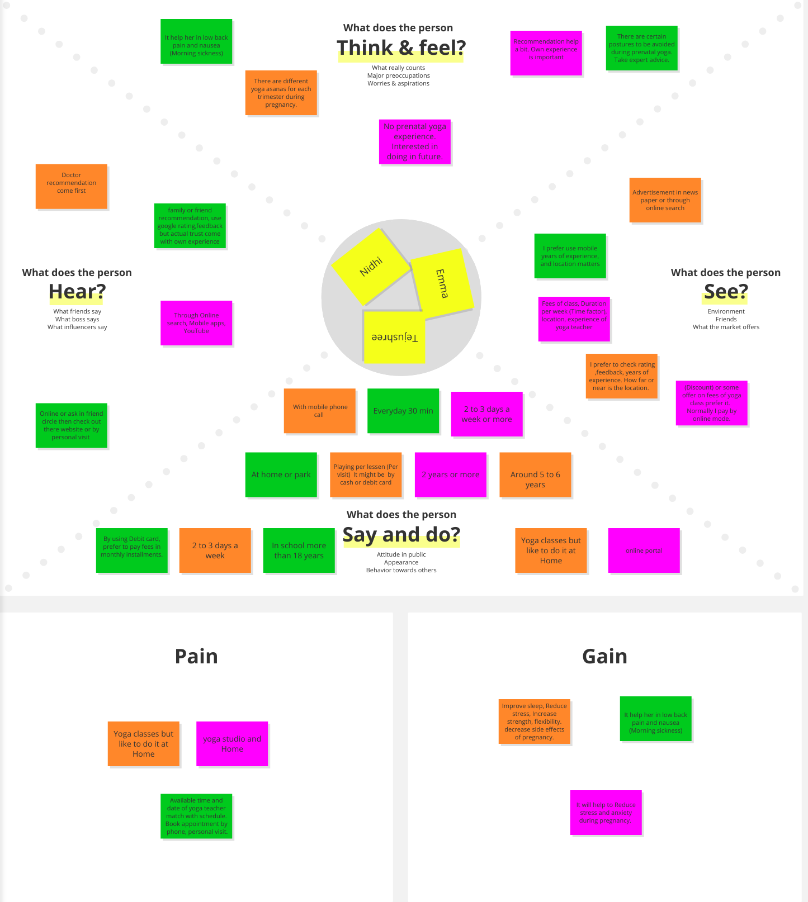
Sort and map the data
Ideas have been arranged in intuitive clusters and categorized to specific findings.
** Click on image to view the digital copy of a board.

Slide 6
Identify user Insights and finding
When searching for the yoga expert, users often rely on their personal opinion and recommendations from their network.
If their doctors recommend the prenatal yoga expert then users prefer to trust them.
Users want to be sure, that yoga expert has a proven record of qualifications and years of an experience, good countable rating and feedback.
Users like to practice the yoga at home but due to unavailability with the current system, they need to go to yoga classes or yoga studio.
Users prefer paying per consultation or in a pre-defined package with discounts.
From the above date, It is clear that users need a way to find the yoga expert because they wish to learn from experts and it would be easily accessible in more convenient way.

Slide 7
Thank you
for reviewing the report.

